Slide 1
Impact of Fire Emissions on Air Quality, Respiratory Disease Incidence, and Healthcare Costs
Alexander He
alexwenzhenhe@gmail.com
hea2@rpi.edu
609-819-1937
School of Science
Rensselaer Polytechnic Institute
Prof. Thilanka Munasinghe (Advisor)
thilankawillbe@gmail.com
munast@rpi.edu
857-998-8767

Slide 2
Objectives
As an undergraduate research project:
Conduct research as a budding practitioner of data science
Utilize skills and knowledge from advanced Computer Science courses involving Machine Learning, Data Science, and Statistics
Perform analysis using statistical and machine learning methods
Build upon existing research work on fire emissions, air quality, and its human health impacts
Test the hypothesis
Wildfires and other fire emissions contribute to higher concentrations of PM2.5 and emitted carbon, thus increasing the incidence/deaths and associated healthcare costs of respiratory diseases
Write a paper for submission to a conference

Slide 3
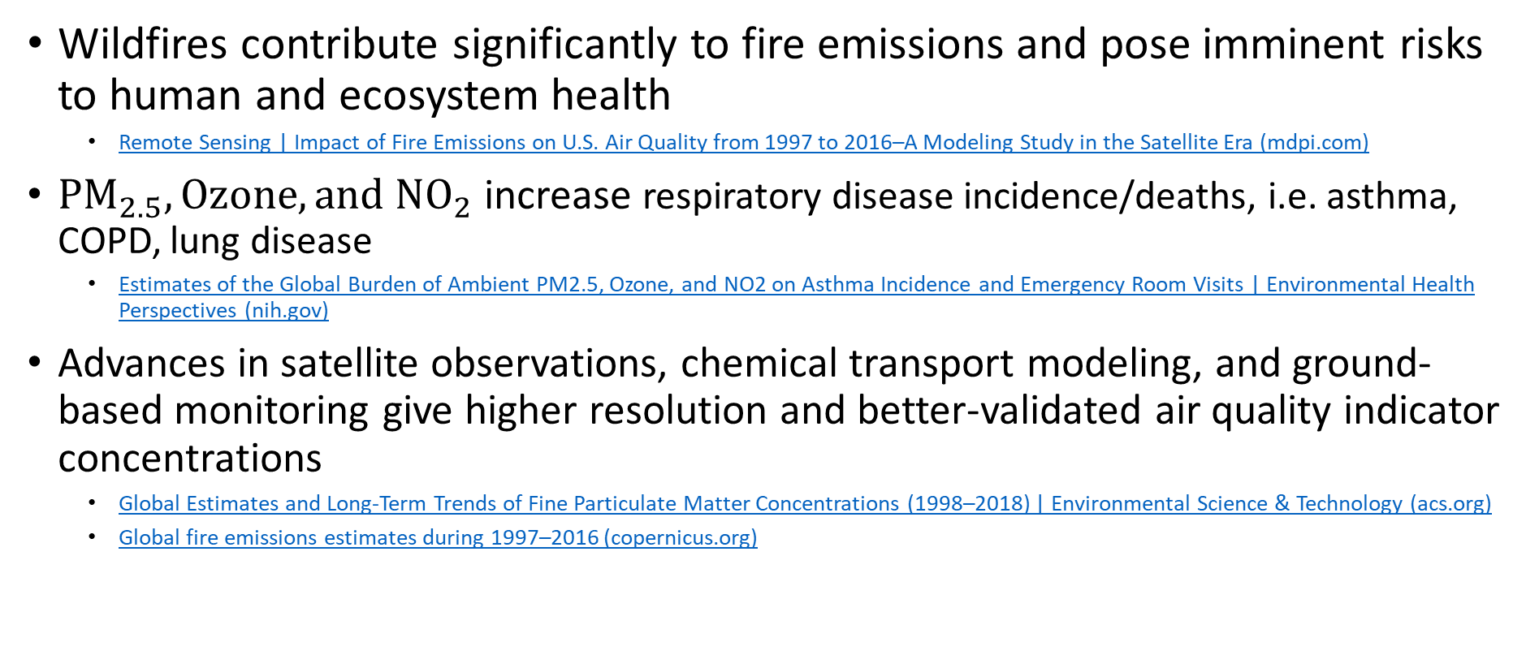
Background
Wildfires contribute significantly to fire emissions and pose imminent risks to human and ecosystem health
Remote Sensing | Impact of Fire Emissions on U.S. Air Quality from 1997 to 2016–A Modeling Study in the Satellite Era (mdpi.com)
$PM_{2.5}, Ozone, and NO_{2}$ increase respiratory disease incidence/deaths, i.e. asthma, COPD, lung disease
Estimates of the Global Burden of Ambient PM2.5, Ozone, and NO2 on Asthma Incidence and Emergency Room Visits | Environmental Health Perspectives (nih.gov)
Advances in satellite observations, chemical transport modeling, and ground-based monitoring give higher resolution and better-validated air quality indicator concentrations
Global Estimates and Long-Term Trends of Fine Particulate Matter Concentrations (1998–2018) | Environmental Science & Technology (acs.org)
Global fire emissions estimates during 1997–2016 (copernicus.org)

Slide 4
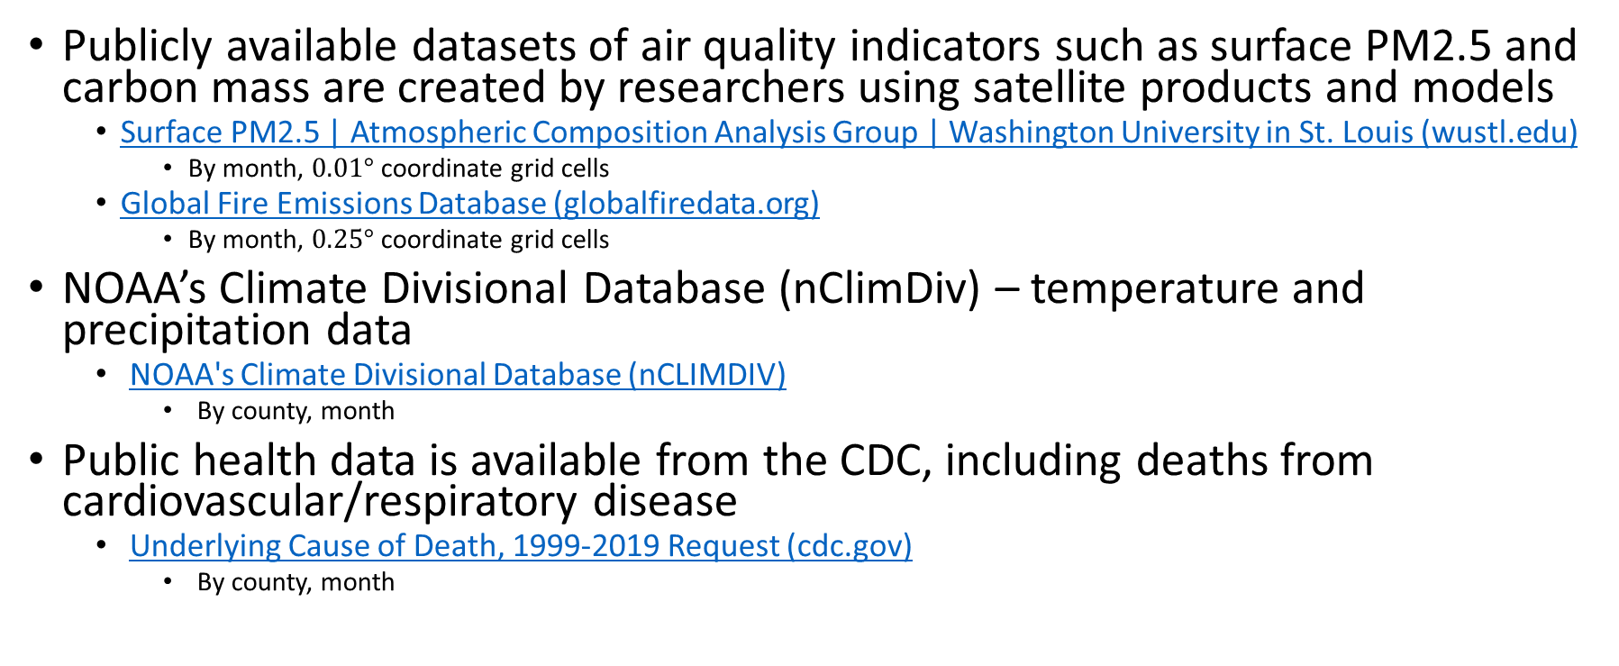
Datasets
Publicly available datasets of air quality indicators such as surface PM2.5 and carbon mass are created by researchers using satellite products and models
Surface PM2.5 | Atmospheric Composition Analysis Group | Washington University in St. Louis (wustl.edu)
By month, $0.01°$ coordinate grid cells
Global Fire Emissions Database (globalfiredata.org)
By month, $0.25°$ coordinate grid cells
NOAA’s Climate Divisional Database (nClimDiv) – temperature and precipitation data
NOAA's Climate Divisional Database (nCLIMDIV)
By county, month
Public health data is available from the CDC, including deaths from cardiovascular/respiratory disease
Underlying Cause of Death, 1999-2019 Request (cdc.gov)
By county, month

Slide 5
Datasets
US County shapefiles
Cartographic Boundary Files (census.gov)
Population data – yearly; monthly data estimated
County Intercensal Datasets: 2000-2010 (census.gov)
County Population Totals: 2010-2019 (census.gov)

Slide 6
Data wrangling
Web search of rich public datasets in the same timeframe
Create visualizations to understand the datasets (next 2 slides)
Prepare data for analysis
Organize all datasets into similar data structures/formats
Use of county shapefiles
Account for county changes since 2000
Total area of land and water (per county) to compute population densities
Aggregate grid cells by county to compute average air quality indicator concentrations

Slide 7
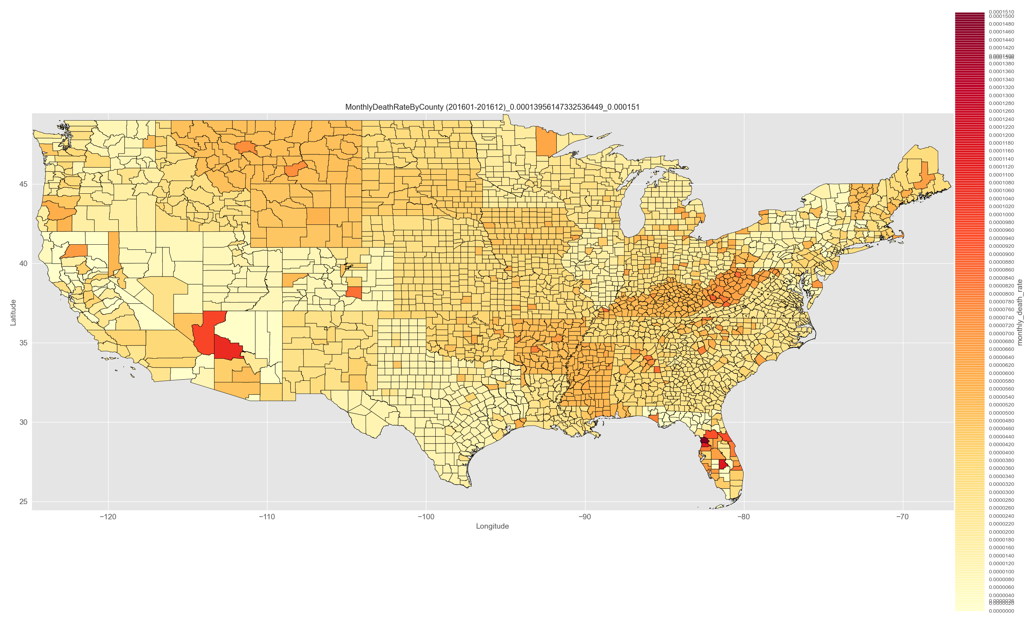
Monthly Death Rate from Respiratory Diseases, 2016/01-2016/12, by county (1-year example)
Research-Spring2021/code/plot_usa-outfiles/monthyDeathRate

Slide 8
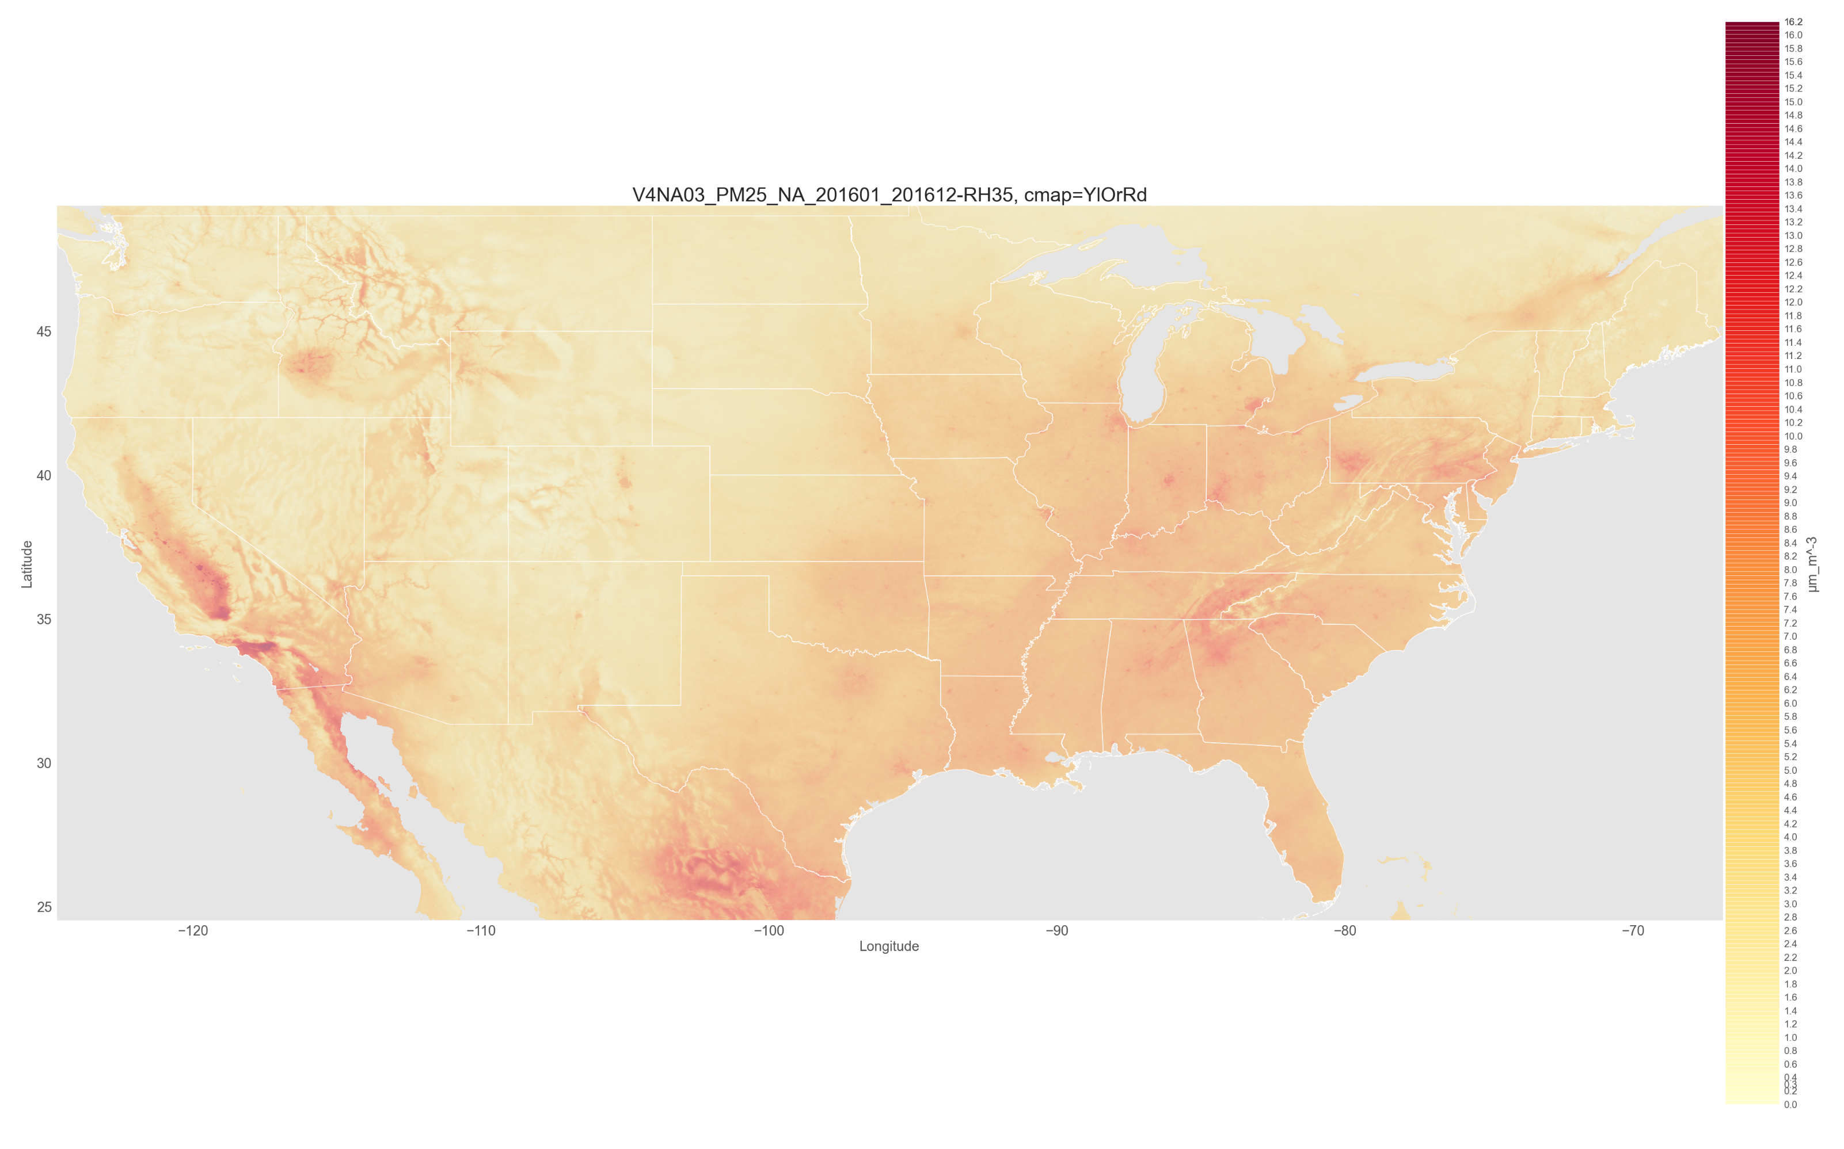

PM2.5 concentration ($μm/m^{3}$), 2016/01-2016/12, $0.01°$ grid cells (1-year example)
Research-Spring2021/code/read_acag_pm2-5-outfiles/TENA_2000-2018

Slide 9
Analysis (In-Progress)
Clustering to identify isolated/recurrent hotspots of PM2.5, carbon emissions
Multivariate analysis between air quality/emission indicators, disease incidence, temperature, precipitation
Random forest regression to rank the importance of variables
Measure seasonal variations in indicator concentrations and death counts

